Slide 1
PATIENT CASE SIMILARITY
PIP2001 Capstone Project
Final Viva
Batch Number : CDV-02
Roll Number | Student Name
20211CDV0033 | Rajeshwari C Raikar
20211CDV0034 | Nisha L
20211CDV0055 | Amruth Raj P
20211CDV0041 | Katta Vinod Kumar
20211CDV0056 | K Vishnu Vardhan
Under the Supervision of,
Mr. Rajan Thangamani,
Assistant Professor,
School of Computer Science and Engineering,
Presidency University,
Bangalore-560064.
Name of the Program: B.Tech Computer Science and Technology [DEVOPS]
Name of the HoD: Dr. S Pravinth Raja
Name of the Program Project Coordinator: Ms. Suma N G
Name of the School Project Coordinators: Dr. Sampath A K / Dr. Abdul Khadar A / Mr. Md Ziaur Rahman

Slide 2
Introduction
The Patient Case Similarity System is a medical web application designed to assist healthcare professionals in identifying similar patient cases based on medical history and conditions. This tool leverages machine learning and natural language processing techniques to streamline patient data analysis, enabling better diagnosis and treatment planning.
Patient Similarity Analysis: Utilizes TF-IDF and Cosine Similarity to identify and rank patient cases with similar medical conditions.
Data Management: Efficient preprocessing and management of patient datasets, including medical conditions, age, gender, and medications.
Appointment System: Features a CRUD-based (Create, Read, Update, Delete) appointment management module for doctors and patients.
User Authentication: Ensures secure access for admins and doctors using a basic authentication mechanism.

Slide 3
Literature Review
1) Importance of Patient Similarity Analysis: Patient similarity analysis has become a critical tool in modern healthcare for improving diagnostic accuracy and personalizing treatment plans. By leveraging historical patient data, clinicians can identify patterns that aid in predicting outcomes and recommending treatments. Research has shown that similarity-based systems enhance decision-making efficiency, particularly in cases involving rare or complex conditions.
Key Studies:
Cao et al. (2017) demonstrated the role of patient similarity networks in personalized medicine, enabling tailored treatments based on shared characteristics among patients.
Shickel et al. (2018) emphasized the importance of text-based data in electronic health records (EHRs) for similarity analysis, highlighting the potential of natural language processing (NLP) techniques.
2) Application of NLP in Medical Text Processing
Natural Language Processing (NLP) has been widely adopted for analyzing unstructured medical data such as clinical notes and patient records. TF-IDF (Term Frequency-Inverse Document Frequency) is one of the foundational techniques used for text representation, while Cosine Similarity is a standard metric for comparing textual data.

Slide 4
Key Insights:
TF-IDF effectively quantifies the relevance of terms in medical text, making it suitable for identifying critical keywords in patient records.
Cosine Similarity has been validated as a robust metric for evaluating the closeness of patient cases in multidimensional vector spaces.
3) Similarity-Based Systems in Healthcare
The use of similarity-based systems in healthcare has gained traction, particularly in decision support systems (DSS). These systems assist in comparing patient cases, clustering similar profiles, and predicting disease progression or treatment outcomes.
Key Examples:
Wang et al. (2020) explored patient clustering using similarity metrics, demonstrating improved diagnostic precision for chronic diseases.
Zhang et al. (2021) highlighted the effectiveness of integrating structured and unstructured data to enhance patient case similarity models.

Slide 5
4) Challenges in Patient Case Similarity Systems:
Developing accurate patient similarity systems involves addressing several challenges:
Handling missing or inconsistent data in patient records.
Balancing computational efficiency with the need for precision in similarity computations.
Ensuring data security and compliance with healthcare regulations like HIPAA.
5) Proposed Solutions:
Leveraging advanced preprocessing techniques for dataset cleaning.
Employing scalable frameworks like TF-IDF and Cosine Similarity to manage large datasets effectively.
6) Relevance of Current Project:
This project aligns with existing research by integrating TF-IDF and Cosine Similarity for analyzing medical conditions. It provides a practical and scalable solution for healthcare providers, addressing the need for efficient and accurate similarity-based analysis in real-world applications.

Slide 6
Research Gaps Identified
The suggested Patient Case Similarity framework aims to rectify these shortcomings through the following innovations:
Hybrid Methodology: By integrating TF-IDF and cosine similarity for similarity assessments, the system efficiently manages high-dimensional data while minimizing information loss.
Improved Interpretability: The system ensures enhanced usability and trust among healthcare professionals by displaying results in an interactive dashboard and employing easily interpretable algorithms.
Scalability and Adaptability: This system is built to accommodate large datasets, allowing it to be used across various institutions and geographical locations.
Focus on Rare Cases: The system incorporates functionalities to identify and emphasize rare cases, aiding better decision-making and facilitating research.
Privacy-Protective Framework: Secure interactions with databases and adherence to privacy regulations guarantee the safeguarding of sensitive patient information.
This review underscores the necessity for a strong, scalable, and interpretable solution for analyzing patient similarity. The proposed system enhances existing approaches while addressing essential gaps, aiming to achieve improved healthcare outcomes.

Slide 7
Proposed Methodology
Data Preprocessing:
Dataset: the dataset, consists of structured attributes such as demographics, symptoms, diagnoses and treatment details.
Data Cleaning: Missing values are imputed using statistical techniques (mean or mode). Outliers are identified and handled to maintain data quality.
Data Transformation: Categorical features are encoded using one-hot encoding. Numerical features are scaled using Min-Max normalization.
2) Feature Engineering:
TF-IDF (Term Frequency-Inverse Document Frequency): TF-IDF is utilized to transform the textual characteristics of the dataset into numerical forms by evaluating the significance of terms in patient cases. It assists in effectively representing the dataset for similarity calculations.

Slide 8
3) Similarity Analysis k-Nearest Neighbors (KNN):
Distance Metric: Cosine similarity is utilized to compute the similarity between patient cases based on their TF- IDF-transformed features.
Hyperparameter Tuning: The optimal value of k is determined through cross-validation, with the best results obtained at k=5. The algorithm returns the top-k most similar patients by their transformed features.
4) System Architecture :
Frontend: A web user interface built with HTML, CSS, and JavaScript, that allows healthcare practitioners to input patient information.
Backend: Implemented using Flask, the back-end performs data preprocessing, TF-IDF transformation, and KNN similarity calculation. REST APIs are used to link the frontend with the database and the trained model.
Deployment: The system will be scaled and accessible through a cloud platform such as AWS or a range of Azure services. APIs will be used to enable interaction between components.

Slide 9
Objectives
Enhance Diagnostic Accuracy: Develop a system to identify and rank similar patient cases to aid healthcare professionals in making informed diagnostic decisions.
Streamline Data Analysis: Utilize machine learning and natural language processing techniques to efficiently analyze patient data and medical records.
Improve Treatment Personalization: Assist in recommending personalized treatments by referencing historical cases with similar medical conditions.
Simplify Appointment Management: Provide a user-friendly system for managing patient-doctor appointments, including creation, updates, and tracking.

Slide 10
Ensure Data Standardization: Implement robust preprocessing techniques to handle and standardize medical data, ensuring consistency and reliability in analysis.
Facilitate Decision Support: Create a similarity-based decision support system (DSS) to assist clinicians in rare or complex medical cases.
Secure Data Handling: Prioritize data security and privacy while adhering to healthcare compliance standards.
Deploy a Scalable Solution: Build a scalable backend system for real-world applications, deployable on cloud platforms like AWS EC2.

Slide 11
System Design & Implementation
System Design
Input Flow:
User submits patient data or queries via the frontend and the data is sent to the backend through RESTful APIs.
Processing Flow:
Data preprocessing (standardizing, cleaning, formatting) occurs in the backend and TF-IDF and Cosine Similarity algorithms compute patient case similarity.
Output Flow:
Top similar cases are returned as JSON and displayed on the dashboard and Appointment data is fetched or updated as needed.

Slide 12
Implementation
Backend Implementation Framework:
Flask Manages routes like /login, /appointments, and /similarity.
Handles CRUD operations for appointment management.
Data Preprocessing Library:
Pandas Cleans and standardizes medical data.
Ensures missing or inconsistent values are handled effectively.
Similarity Analysis Algorithms:
TF-IDF Vectorization: Converts medical condition text into numerical vectors.
Cosine Similarity: Compares vectors to find the closest matches.
User Authentication: In-memory user credentials validate login requests.
Error Handling: Custom error handlers (404, 500) ensure graceful error reporting.
Deployment Environment: AWS EC2 Offers scalability and reliability for hosting the web application.

Slide 13
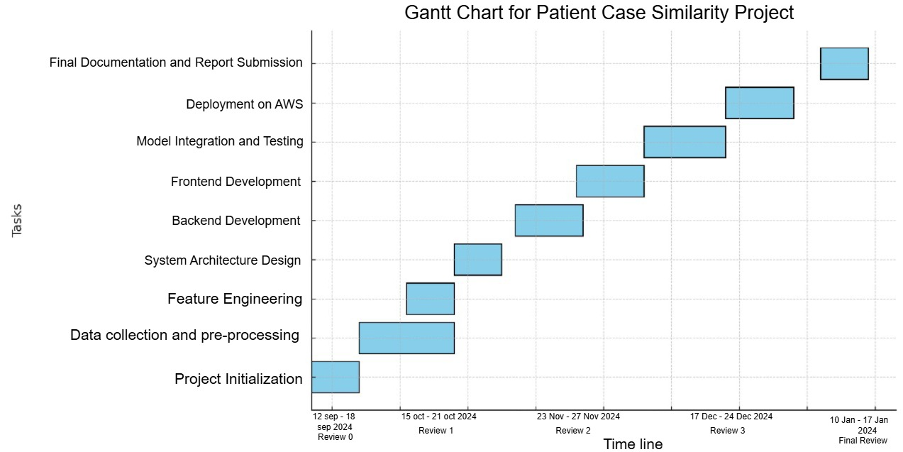
Timeline of Project

Slide 14
Results Obtained
Patient Case Similarity
Successfully identifies and ranks top 5 similar patient cases based on medical conditions, age, gender, and other features.
Provides healthcare professionals with quick access to historical cases, enabling informed decision-making.
Appointment Management
Allows efficient handling of patient-doctor appointments with features to create, update, delete, and fetch appointment details.
Simplifies the administrative workload for healthcare providers.
Improved Data Analysis
Robust data preprocessing ensures clean, standardized input for analysis, reducing errors in similarity computation.
Efficient use of TF-IDF Vectorization and Cosine Similarity achieves accurate similarity rankings with minimal computational overhead.

Slide 15
Scalable and Accessible Backend
A Flask-based backend ensures modularity and scalability, making it easy to extend or integrate with other systems.
Deployment on AWS EC2 provides a reliable and accessible platform for real-world usage.
User-Friendly Interface
Delivers a clean and intuitive interface for users to interact with the system, including patient case similarity analysis and appointment scheduling.
Enhanced Decision Support
Provides healthcare professionals with a decision-support tool to assist in diagnosing and planning treatment for complex or rare medical cases.
Real-Time Processing
Processes patient data and returns similarity results in real-time, ensuring a seamless user experience.
These outcomes highlight the project’s potential to improve healthcare workflows, enhance diagnostic accuracy, and save time for medical practitioners.

Slide 16
Conclusion
The Patient Case Similarity System effectively applies TF-IDF Vectorization and Cosine Similarity to identify and rank similar patient cases.
Provides healthcare professionals with valuable insights for diagnosis and treatment planning.
Features a user-friendly platform for patient data analysis and appointment management.
Ensures real-time performance through a scalable, Flask-based backend.
Incorporates robust data preprocessing for accuracy and reliability in similarity computations.
Planned deployment on AWS EC2 ensures accessibility and scalability for real-world use.
Offers a modular design, allowing future enhancements like advanced algorithms, larger datasets, or EHR integration.
Contributes to modernizing healthcare workflows, enhancing diagnostic precision, and supporting personalized treatment.

Slide 17
References
[1] Conroy, B., Xu-Wilson, M., & Rahman, A. (2017). Utilizing population statistics and multiple kernel learning for patient similarity. Proceedings of Healthcare Machine Learning 2017 JMLR W&C Track. https://proceedings.mlr.press/v68/conroy17a.html
[2] Dai, L., Zhu, H., & Liu, D. (2020). Patient similarity: Techniques and uses. arXiv. https://arxiv.org/abs/2012.01976
[3] Haboubi, S., & Ben Cheikh, A. (2021). Resemblance among patients in forecasting models utilizing healthcare information: The scenario of self-prescribed medications for individuals with diabetes. International Journal of Computers, 6, 33-38. https://www.iaras.org/iaras/journals/ijcOei
[4] Jia, Z., Zeng, X., Duan, H., Lu, X., & Li, H. (2020). A model for diagnostic prediction based on patient similarity. International Journal of Medical Informatics, 135, Article 104073. https://doi.org/10.1016/j.ijmedinf.2019.104073
[5] Liu, Y. (2022). A set of algorithms for assessing patient similarity using electronic health records [Master’s thesis, Concordia University]. Concordia University Library. https://doi.org/10.1109/ACCESS.2022.3142100&#8203;:contentReference[oaicite:0]

Slide 18
[6] Mahima, V. B., Jeevinee, V., & Khan, M. S. (2024). Similarity in patient cases. International Research Journal of Modernization in Engineering Technology and Science, 6(1), 835–838. https://doi.org/10.56726/IRJMETS48246
[7] Memarzadeh, H., Ghadiri, N., Samwald, M., & Lotfi Shahreza, M. (2022). Research on patient similarity via representation learning from healthcare records. arXiv. https://doi.org/10.21203/rs.3.rs-1738458/v1&#8203;:contentReference[oaicite:1]
[8] Seligson, N. D., Warner, J. L., Dalton, W. S., Martin, D., Miller, R. S., Patt, D., ... Chen, J. L. (2020). Suggestions for patient similarity categories: Outcomes from the AMIA 2019 workshop on defining patient similarity. Journal of the American Medical Informatics Association, 27(11), 1808–1812. https://doi.org/10.1093/jamia/ocaa159
[9] Siri, D. L., Charitha, K., Varsha, K., & Pramod, K. (2023). Enhancing clinical decision assistance by comparing patient case similarities. International Journal of Innovative Research Ideas, 11(12), 680-685. https://www.ijcrt.org/IJCRT2312749

Slide 19
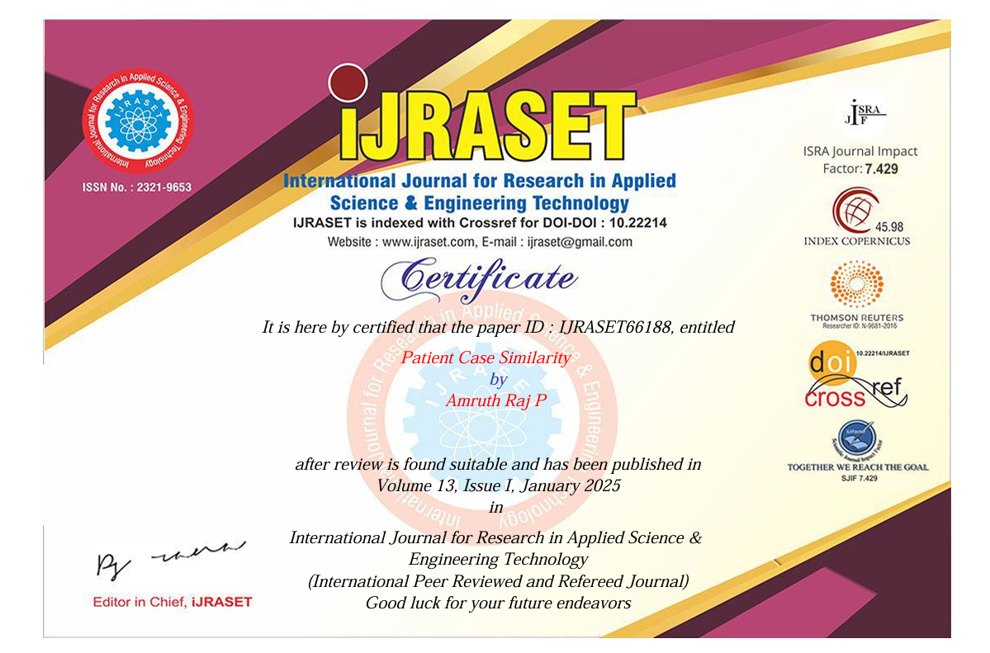
Publication Details

Slide 20
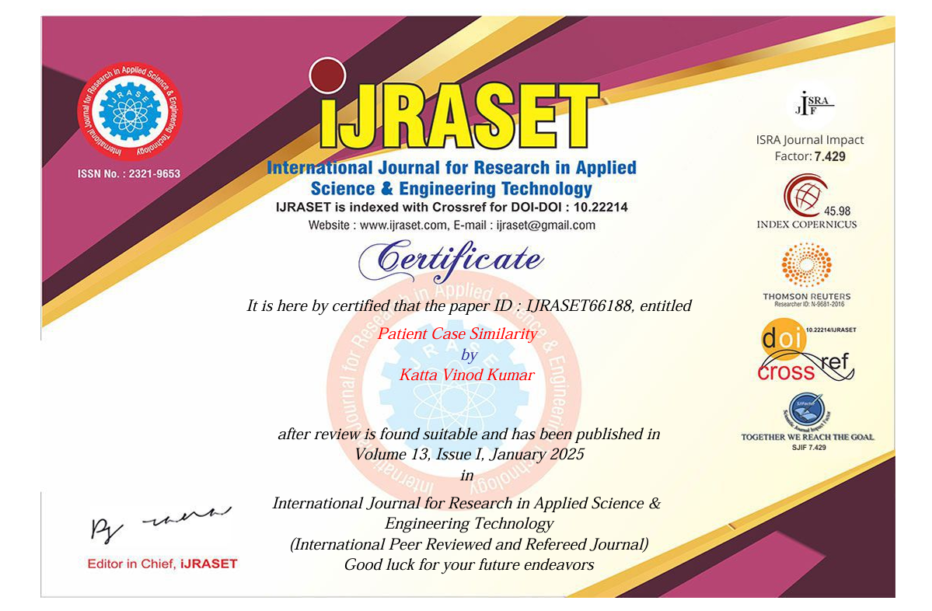

Slide 21


Slide 22
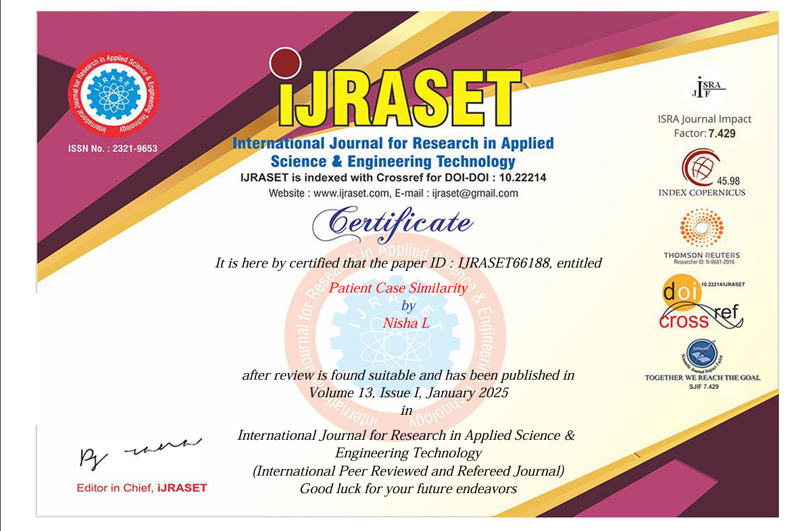

Slide 23
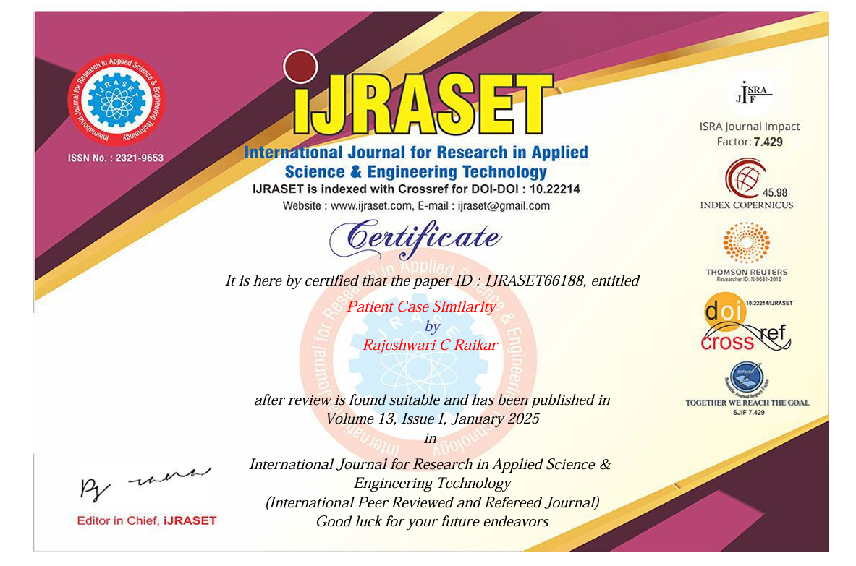

Slide 24

Thank You

